Slide 1
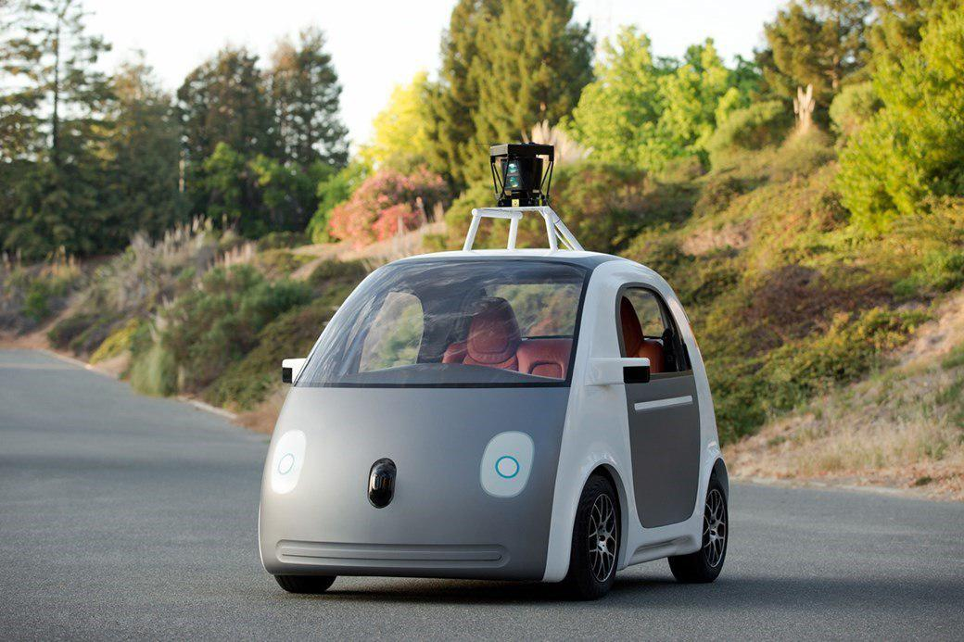
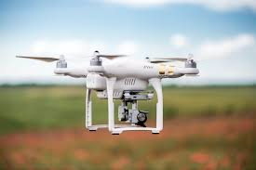


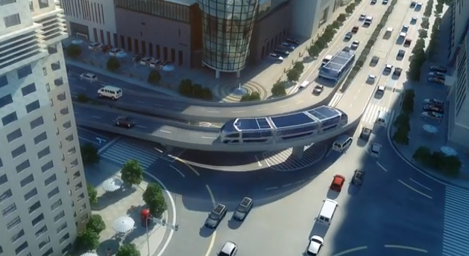


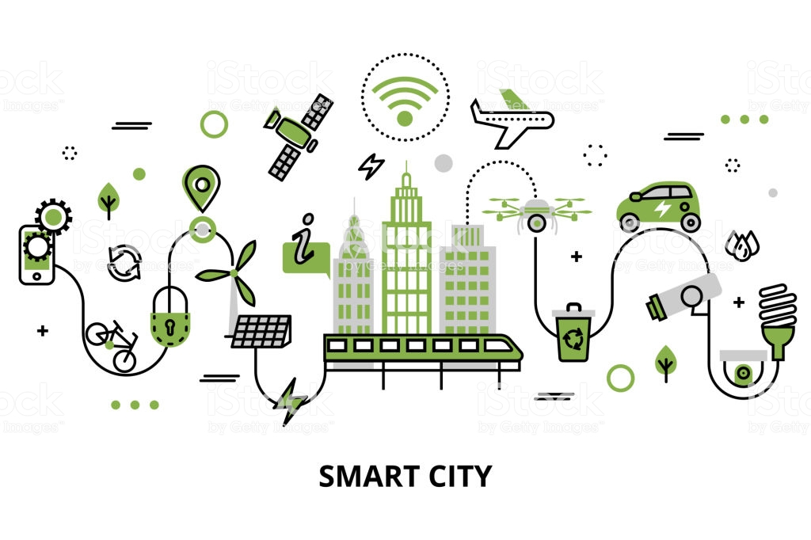



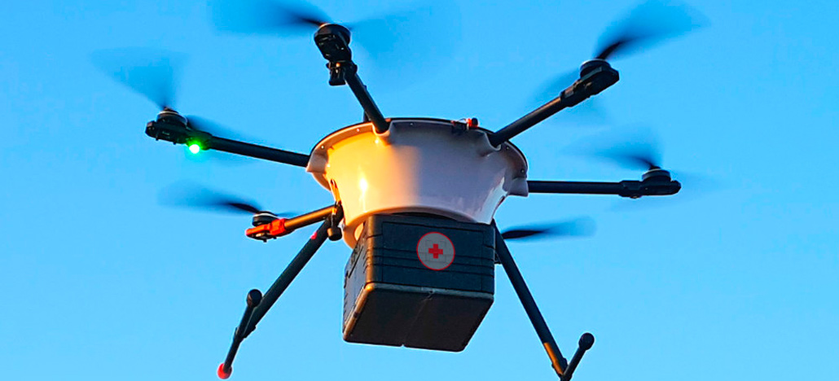
New transportation Technologies

Slide 2

How did people imagine the technology would be today?

Slide 3
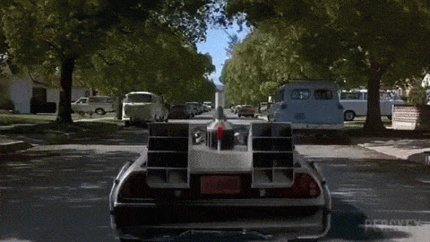
How did people imagine the technology would be today?

Slide 4

But, we can say that things have really changed or not:

Slide 5

I’m beige.

Slide 6




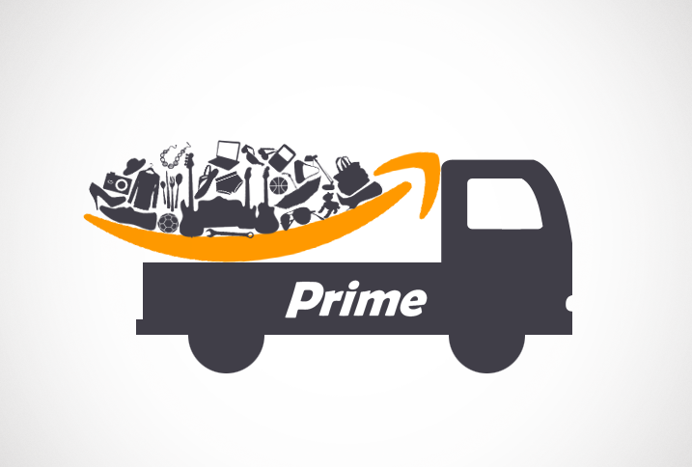
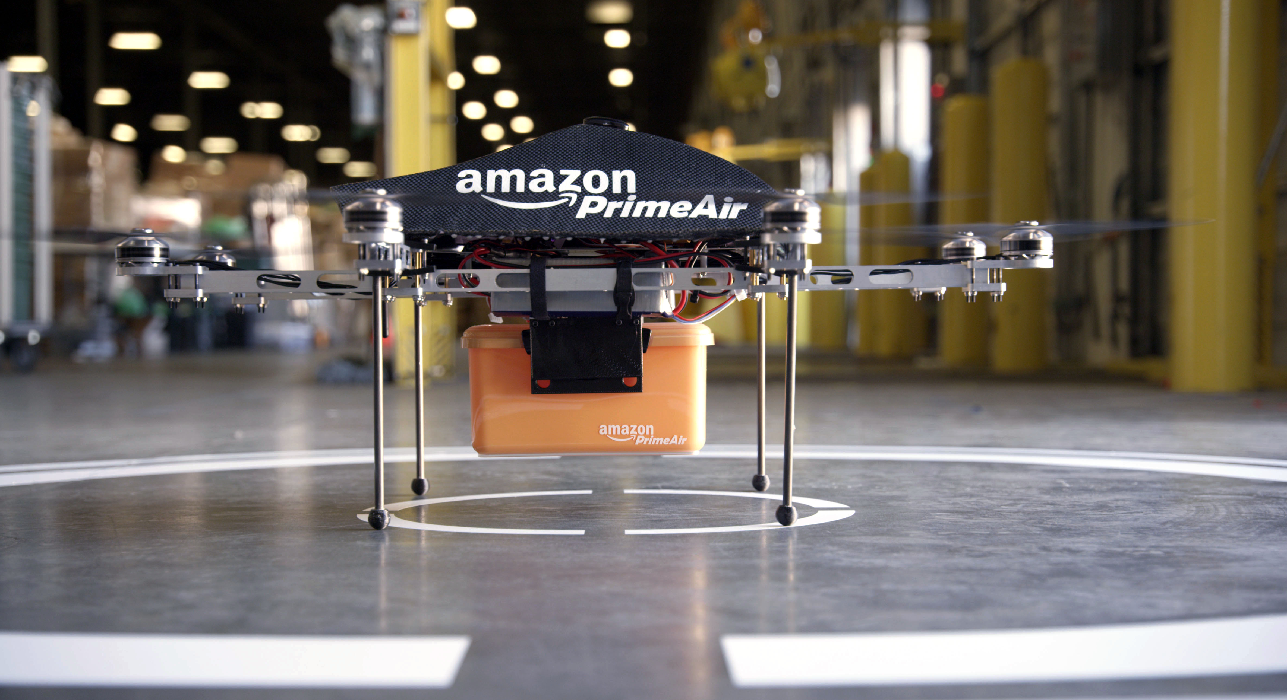
DRONES
Amazon Prime Air.

Slide 7
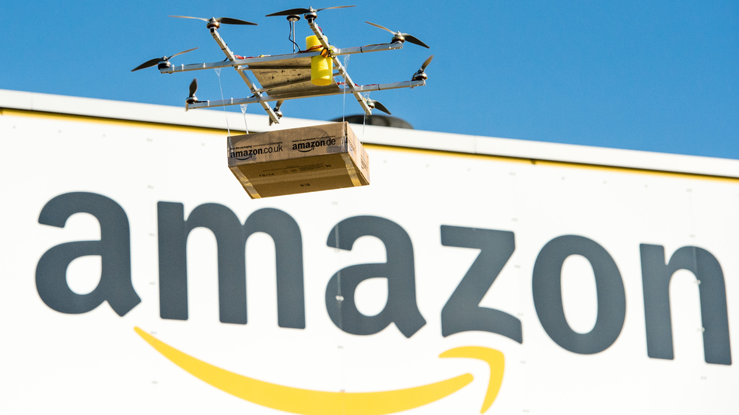

But, now let’s get to the point, the new technologies created for Amazon, also called drones, but not the simple drones, although almost unimaginable 30 years ago, now it’s real, and, according to the Amazon, one day, seeing Prime Air vehicles will be as normal as seeing mail trucks on the road.

Slide 8
Amazon Prime Air is a service that will deliver packages up to five pounds in 30 minutes or less using small drones. They are testing the vehicles in multiple international locations.
And it’s the characteristics are safety and security are top priorities as they look to incorporate small drones into the airspace. They're working with regulators and industry to design an air traffic management system that will recognize who is flying what drone, where they are flying, and whether they are adhering to operating requirements.

Slide 9

It’s therefore a future delivery system from Amazon designed to safely get packages to customers in 30 minutes or less using unmanned aerial vehicles. Prime Air has great potential to enhance the services we already provide to millions of customers by providing rapid parcel delivery that will also increase the overall safety and efficiency of the transportation system.

Slide 10


Slide 11
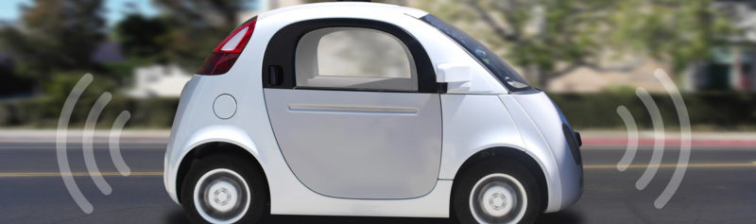


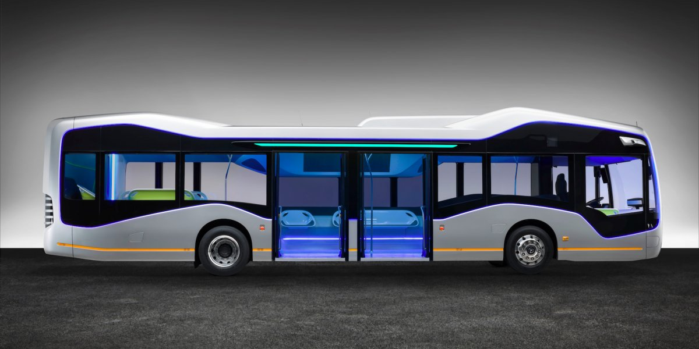
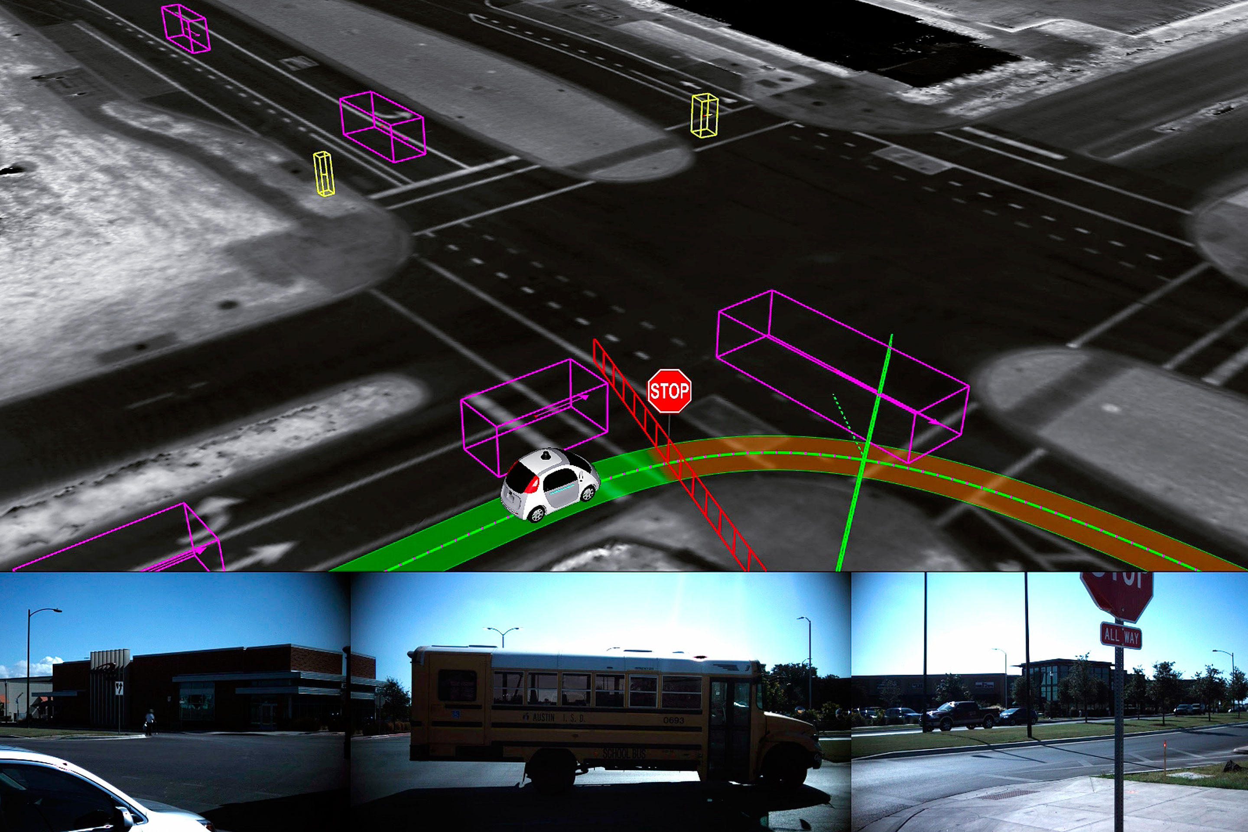
Autonomous car

Slide 12
AND
Goal:
Firefly
Bring self-driving technology
Improve mobility

Slide 13
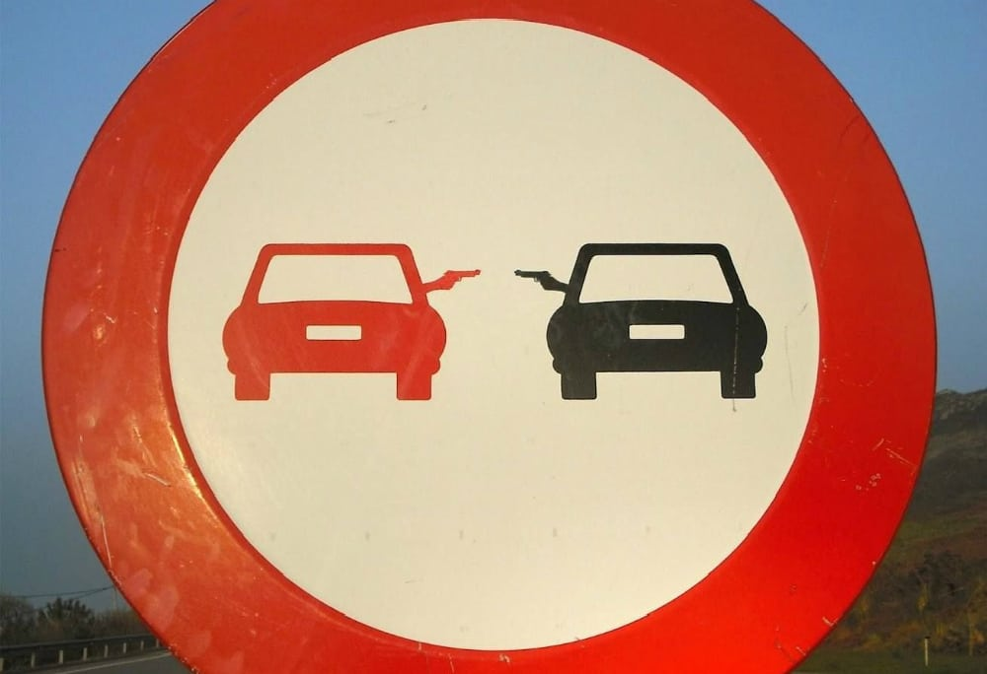
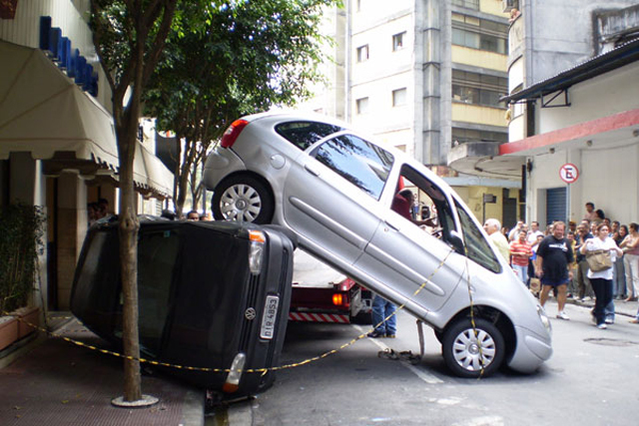
Why is the Autonomous car important?
Driving today is not as safe or enjoyable as it should be.

Slide 14
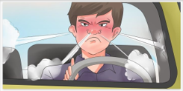
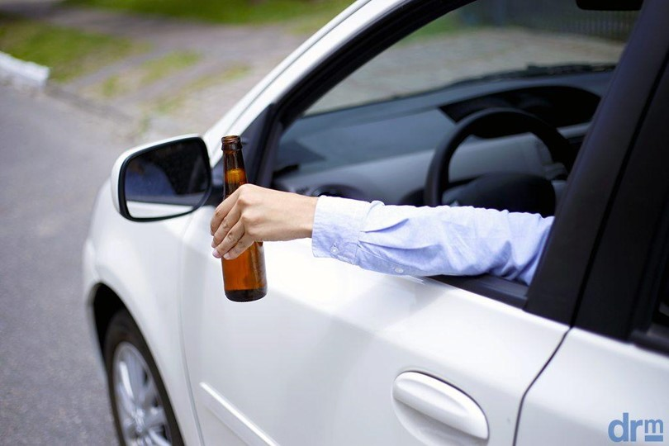
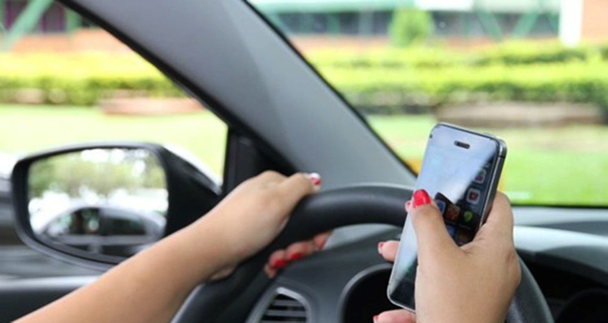

STRESSED / ANGRY
DRUNKED
DISTRACTED
VERY SLEEPY

Slide 15
HOW DOES IT WORK?
System of Satellite location
Cameras
Sensors to identify any obstacle

Slide 16
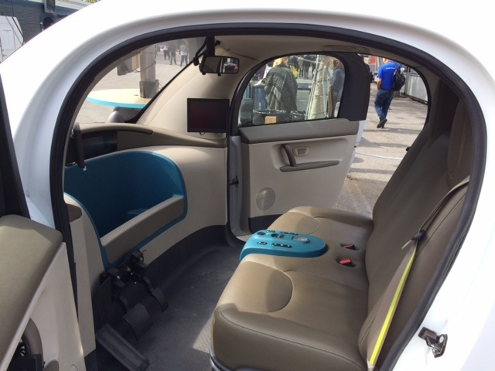
Inside
Monitor
Steering Wheel
Pedals
Seat

Slide 17
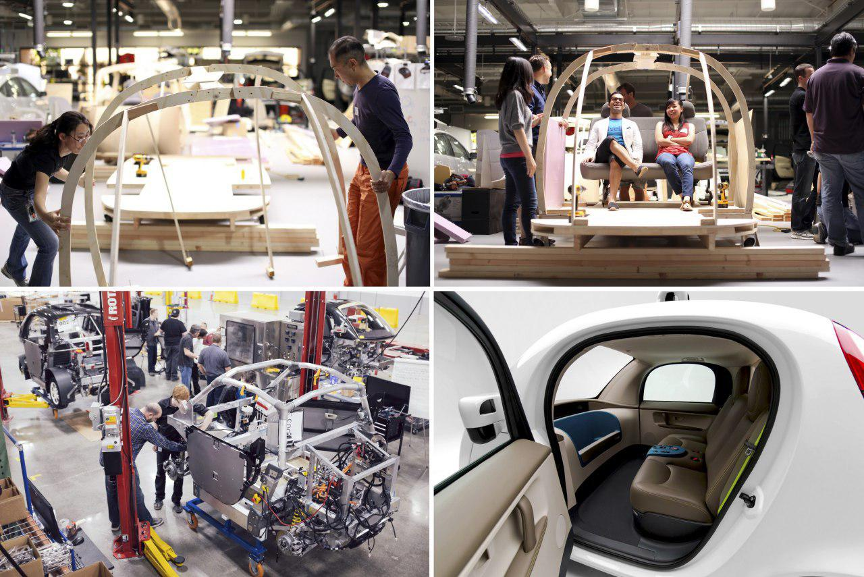
Wood

Slide 18
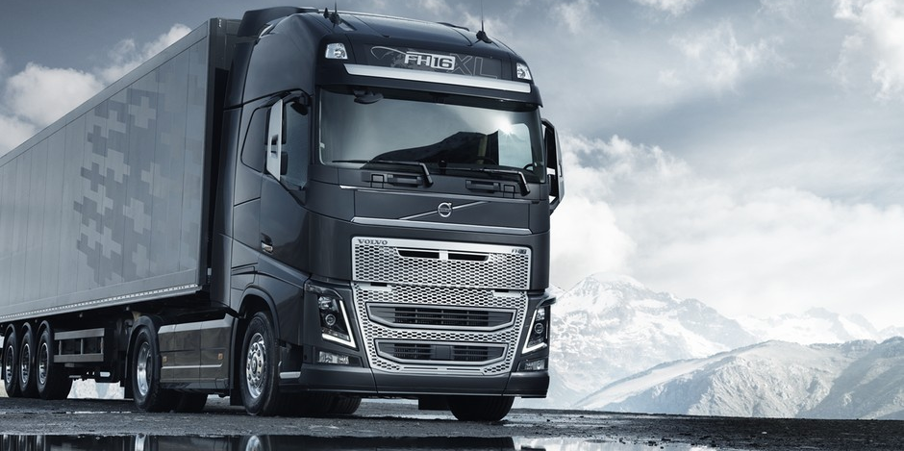
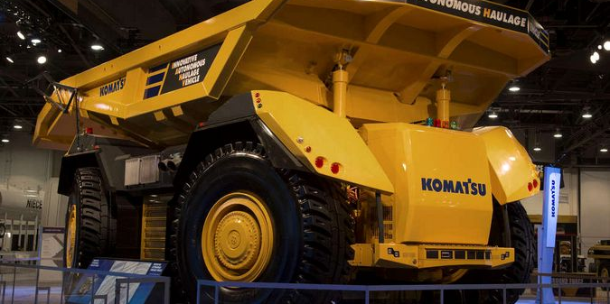
VOLVO
KOMATSU
MERCEDES-BENZ

Slide 19
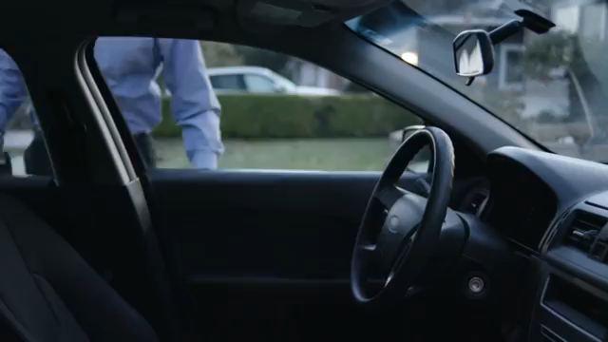

Slide 20
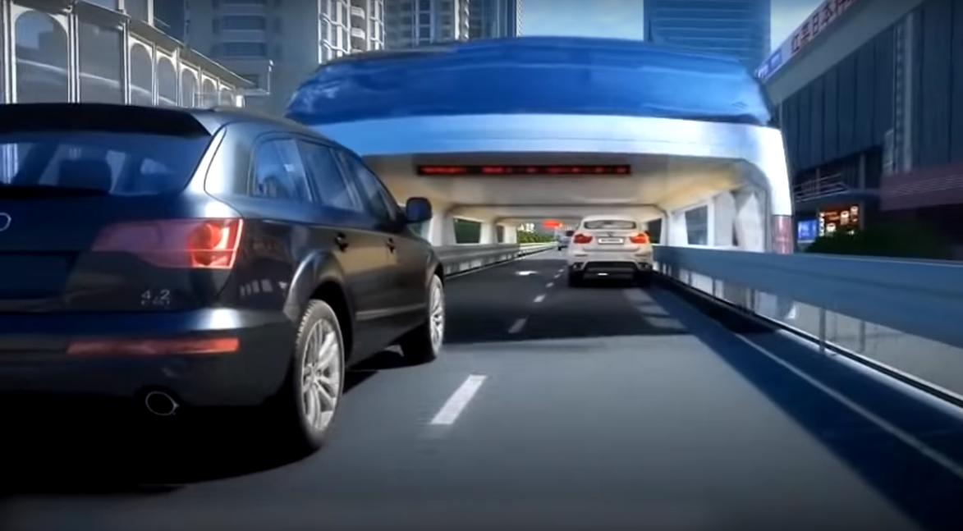
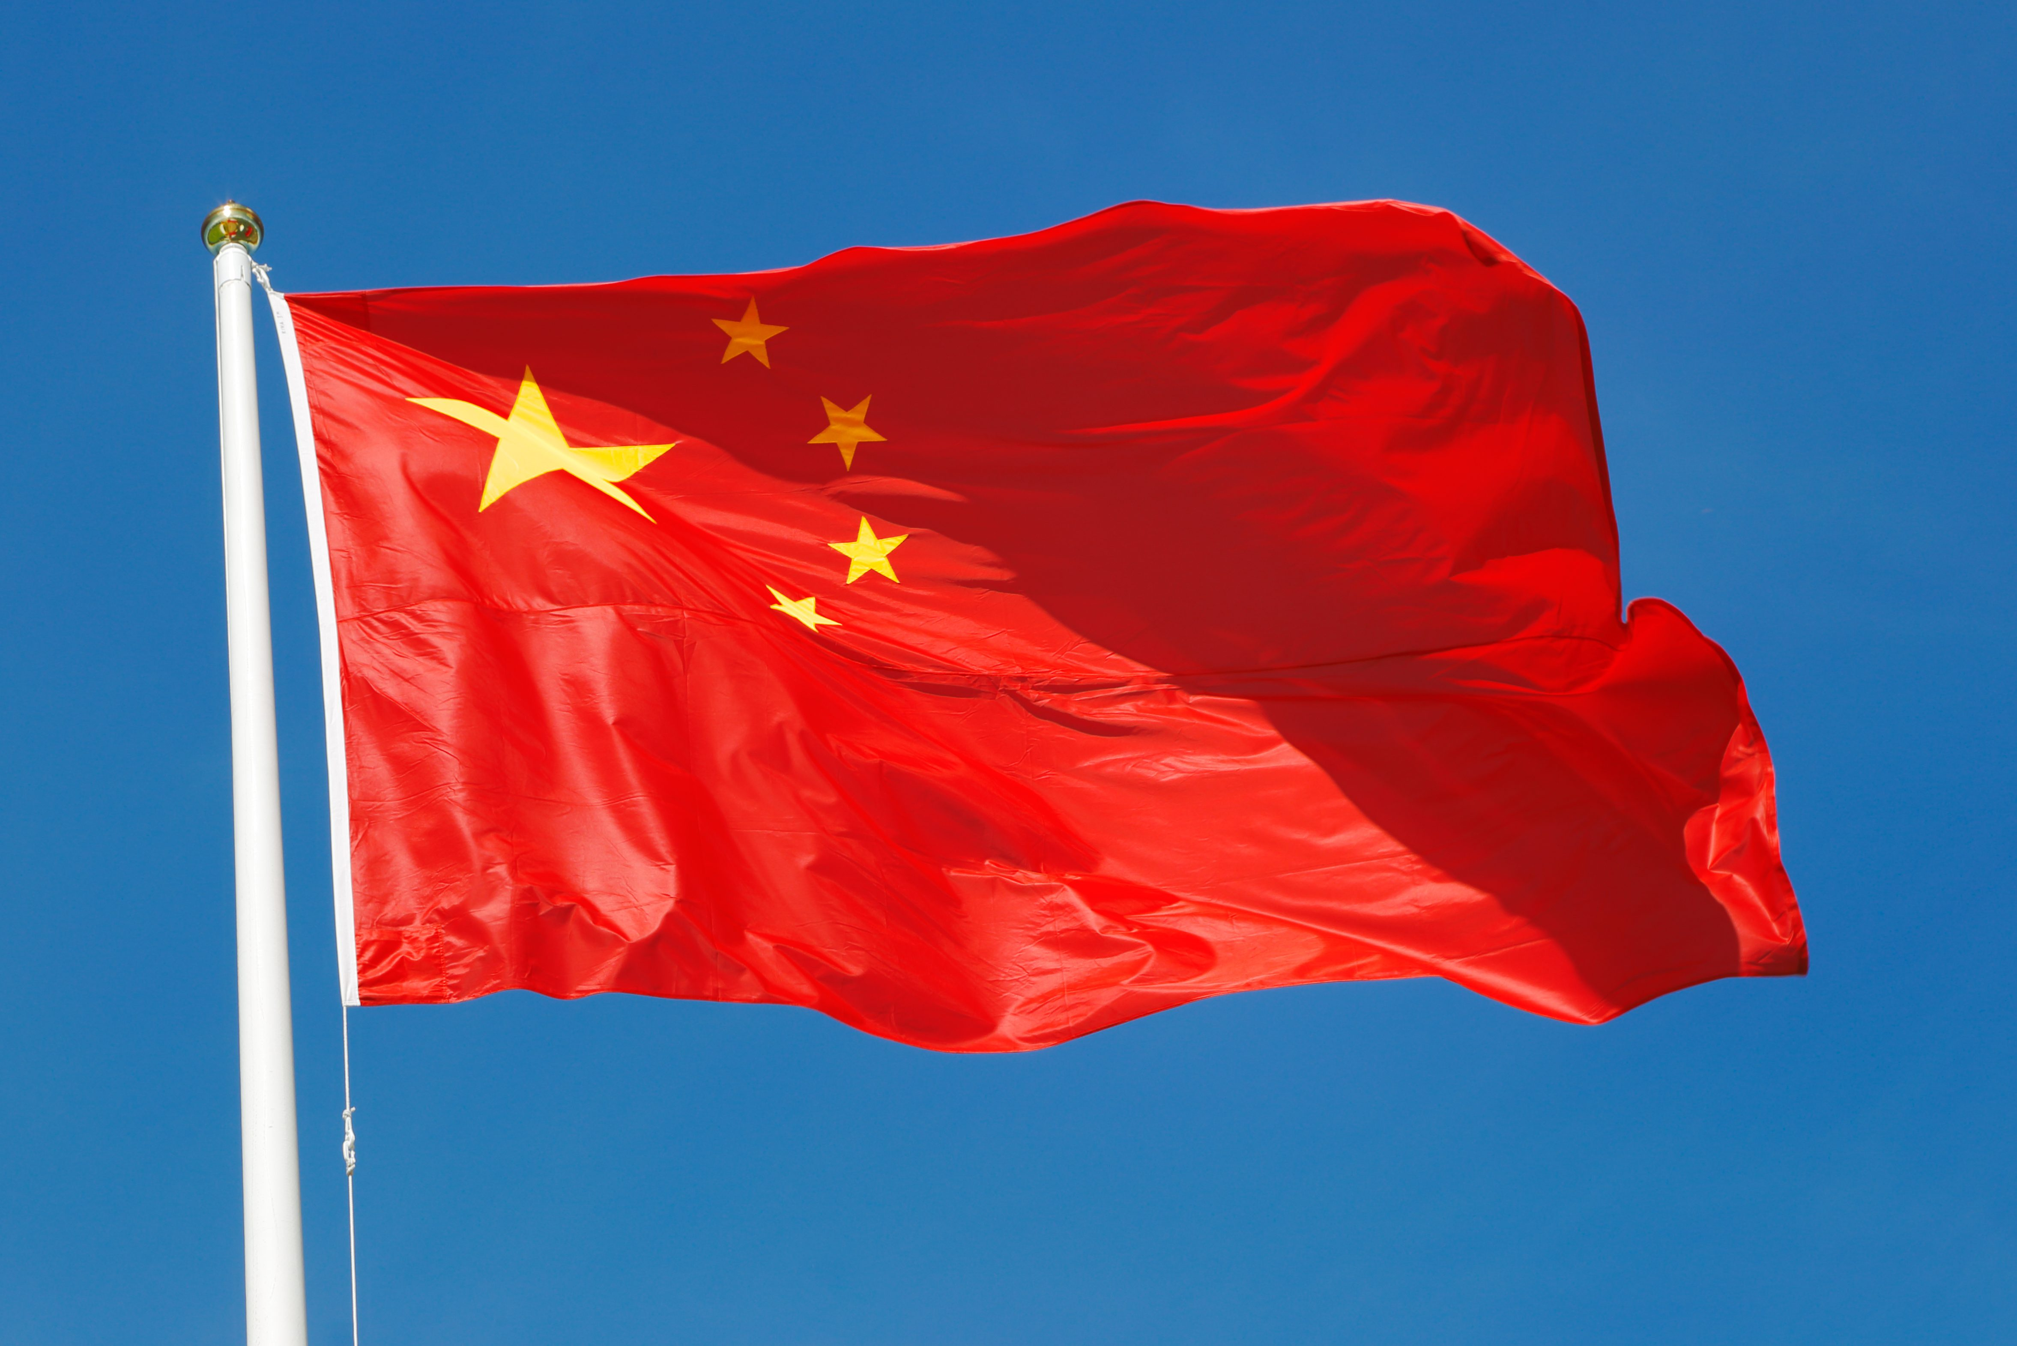

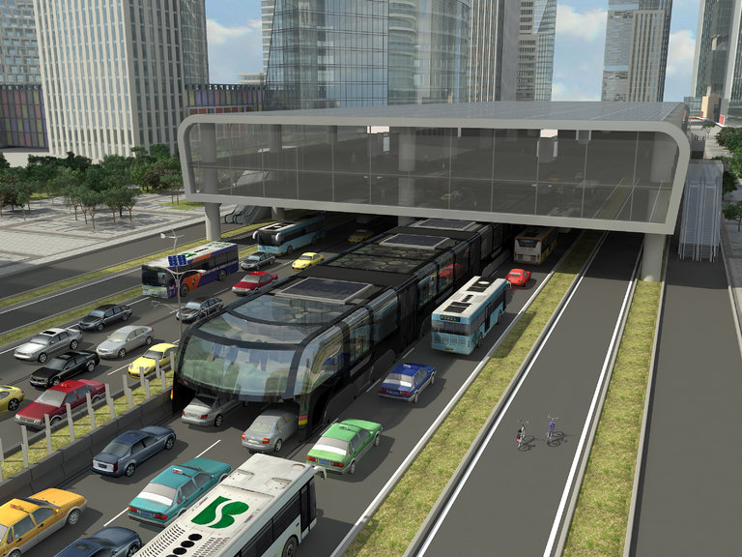
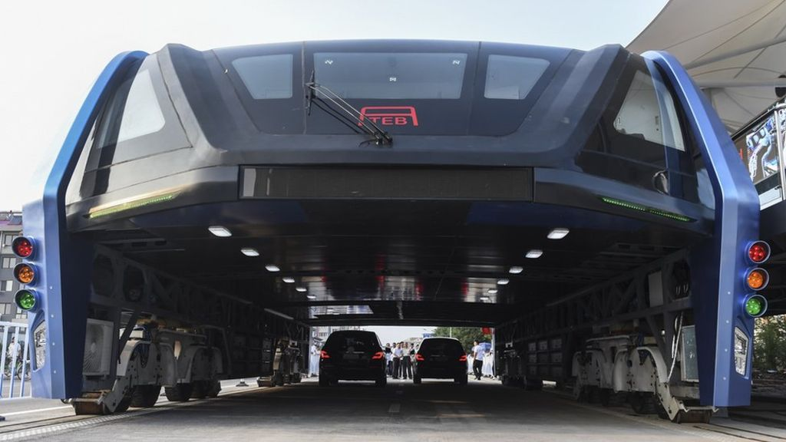
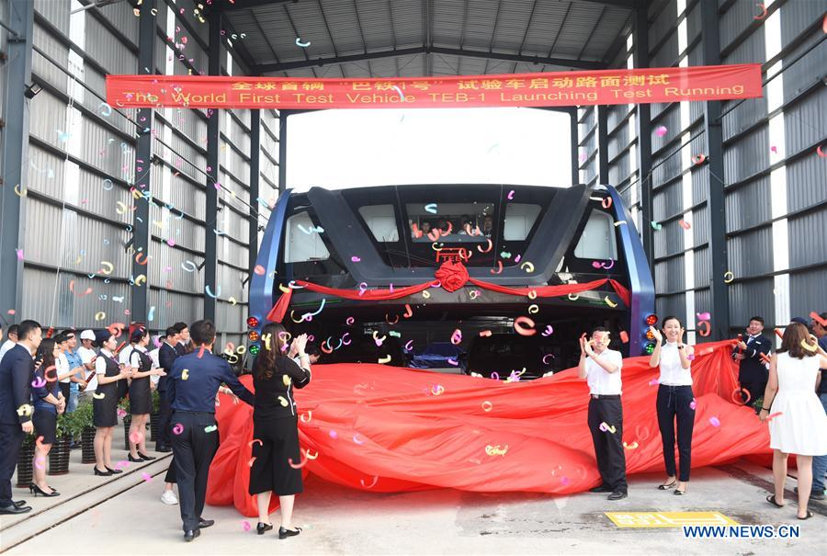
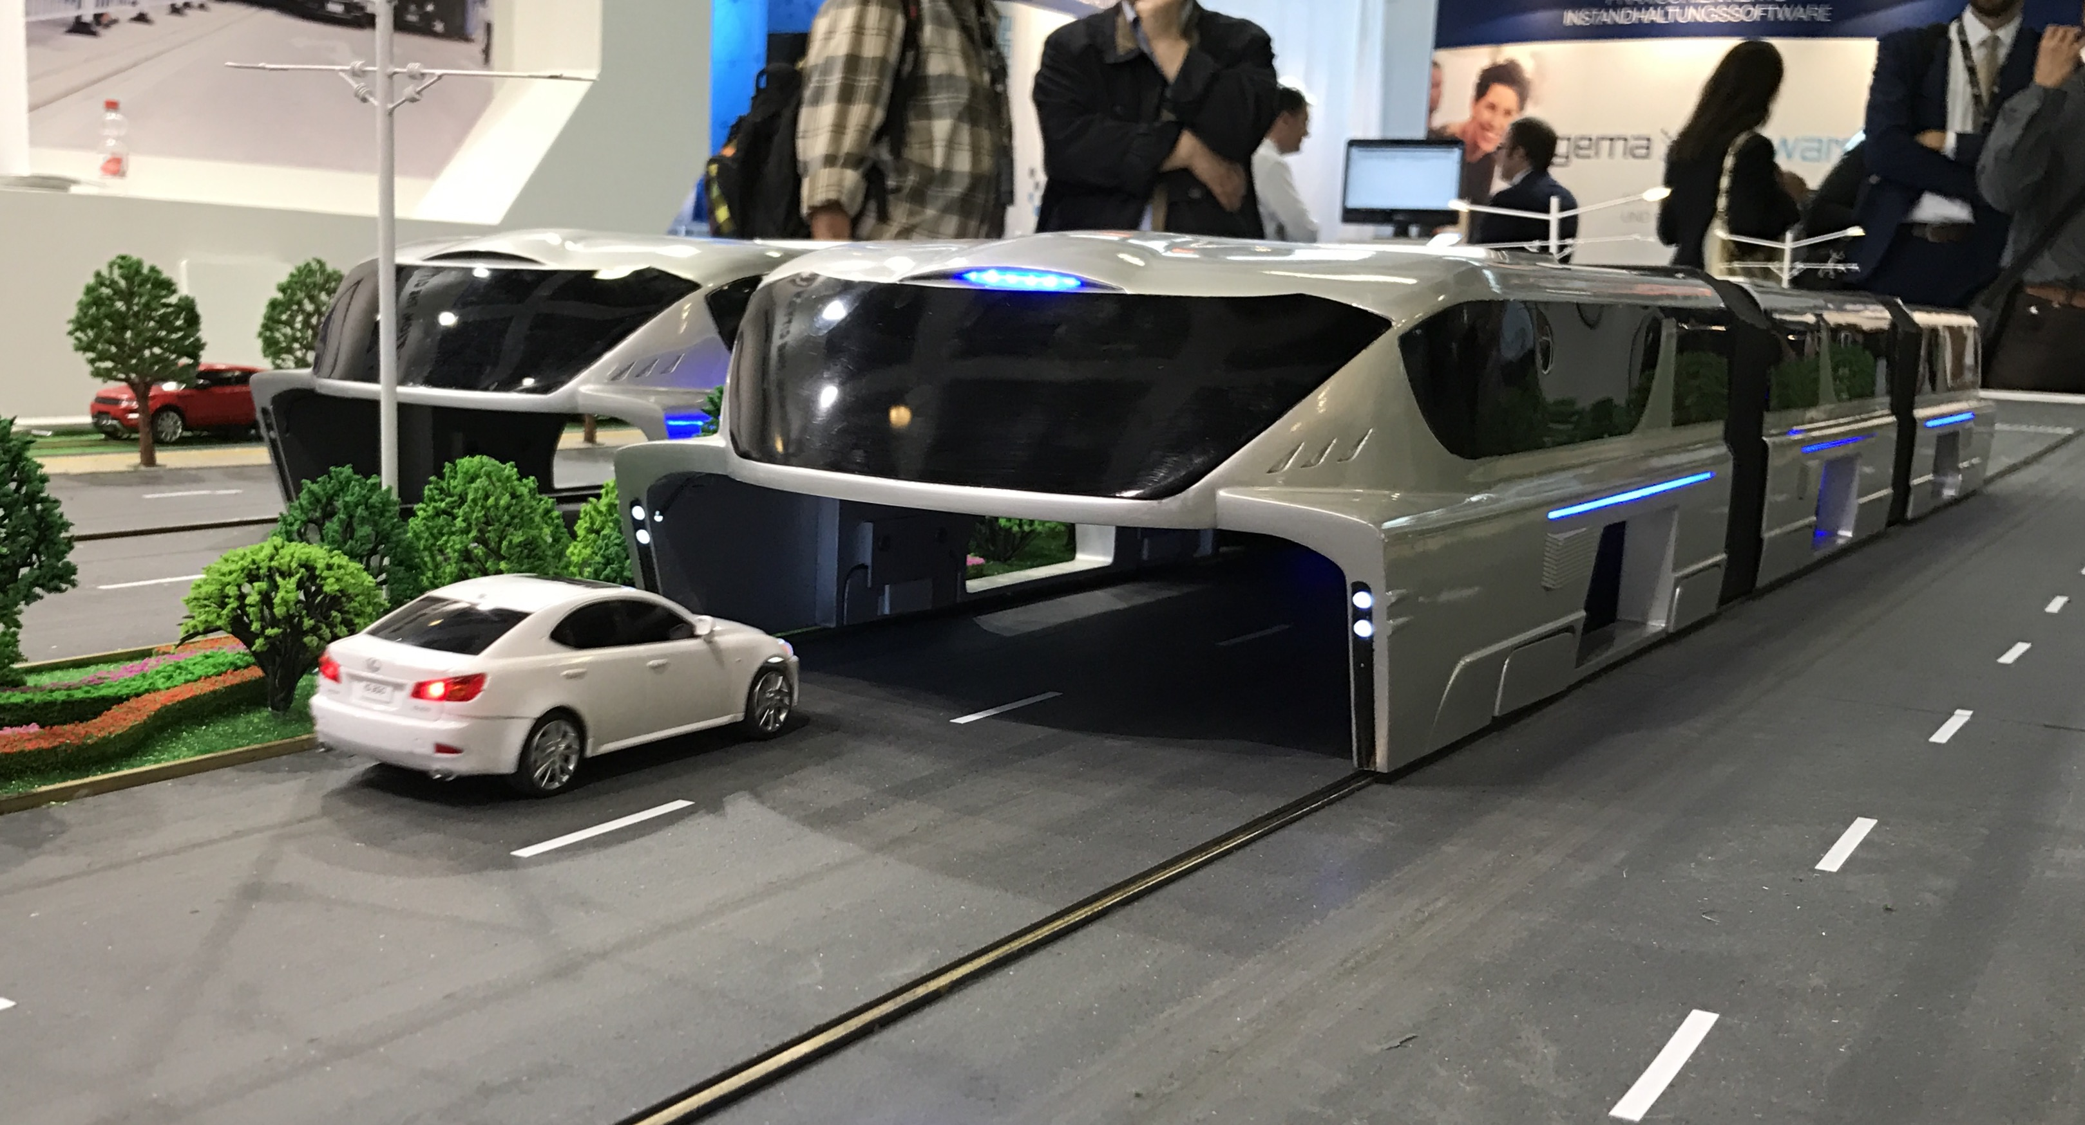
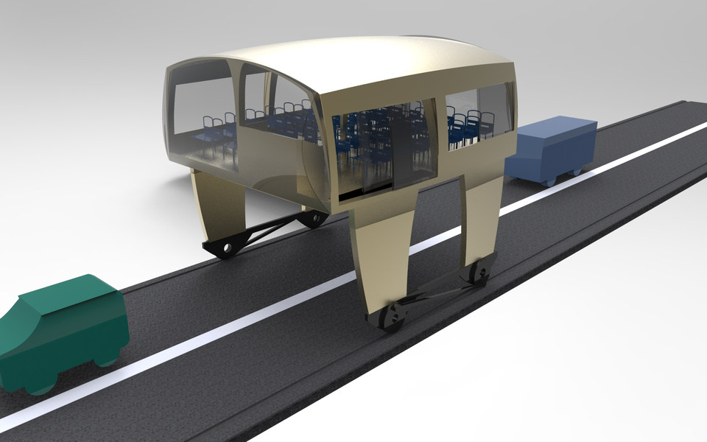
China and your Project of
TRANSIT ELEVATED BUS

Slide 21
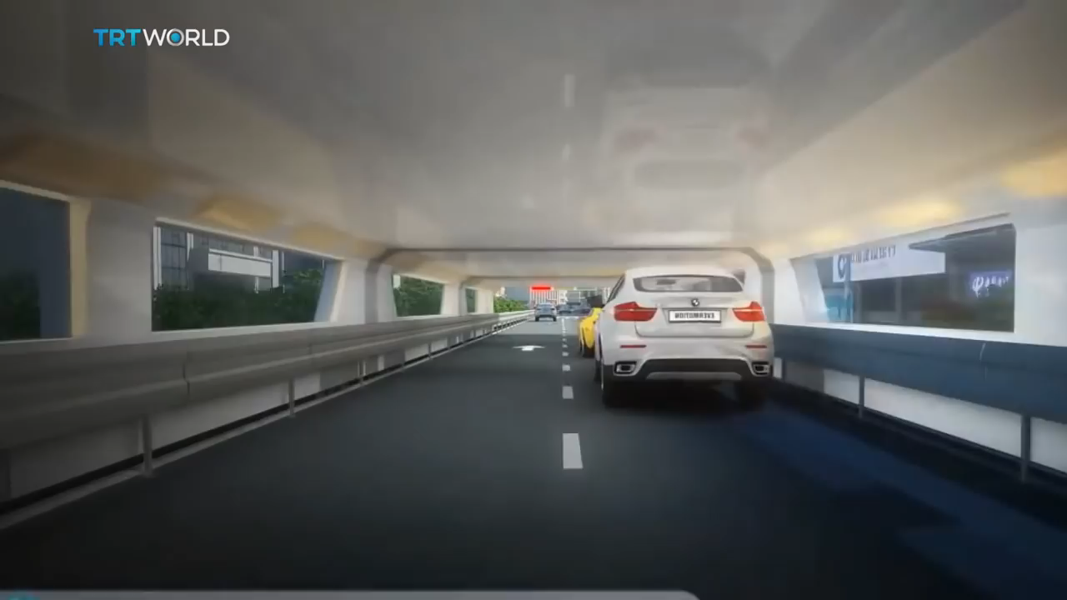

Slide 22
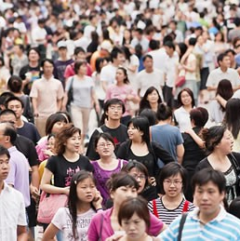
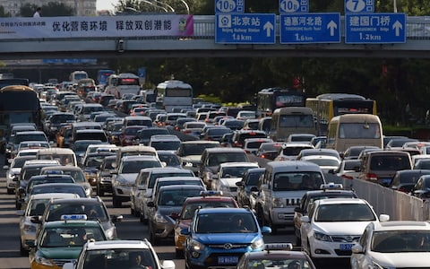

CHINA:
Is the most populous country in the world.
Has a traffic jam.

Slide 23
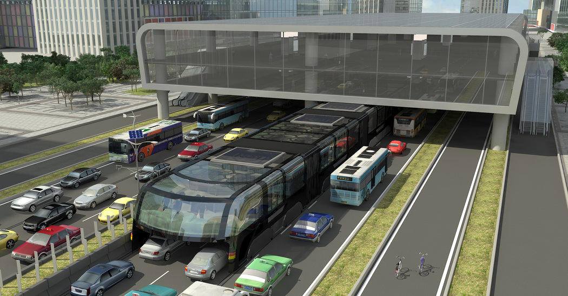
IN 2013 CHINA INTRODUCED THE TEB (TRANSIT ELEVATED BUS)
To free the chinese traffic

Slide 24
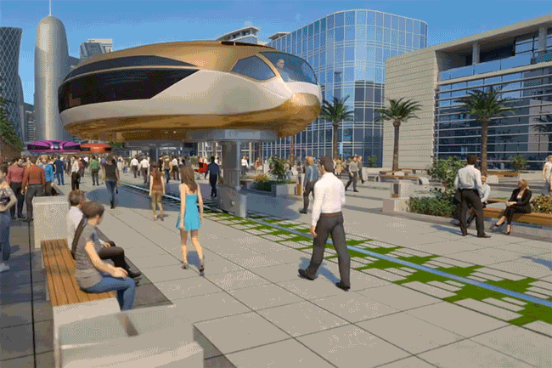
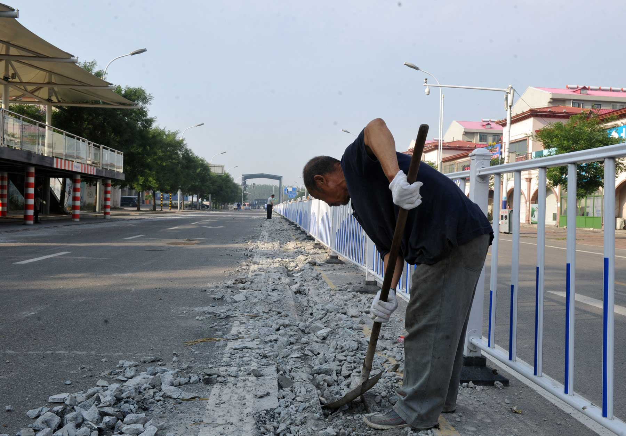
QINGHUANGDAO CITY
The inaugural run was conducted on a 300 metre-long track, separate from road traffic.
In 2017 the rails were removed
😒

Slide 25
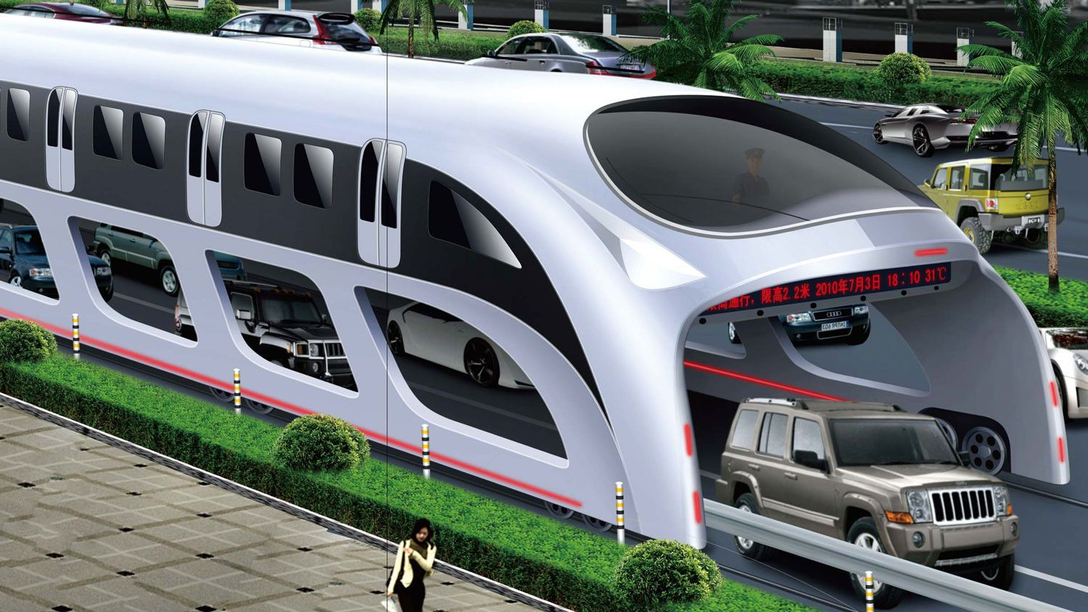
Transit Elevated Bus
It was tested in August 2016 .
The first wagon has a capacity of 300 passengers .

Slide 26
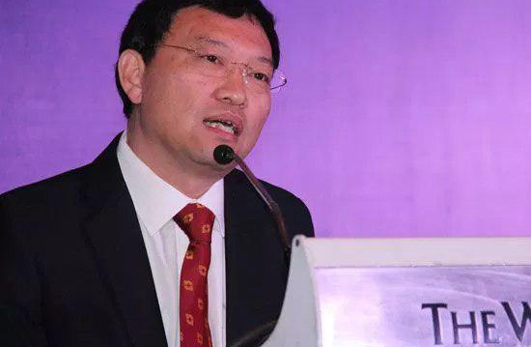
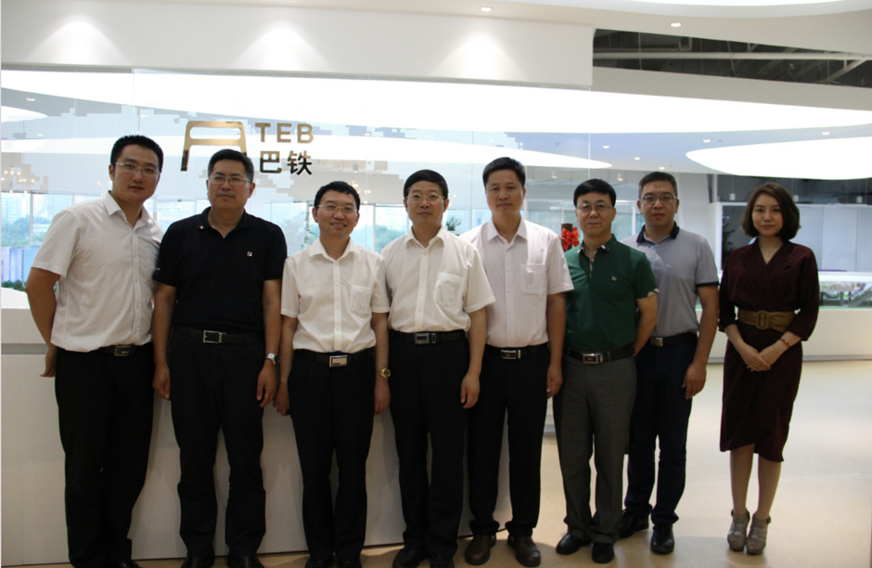
👍
THE CEO
Bai Zhiming
Project was investigated by police and 32 people were arrested for taking part in a private investment publicity stunt.

Slide 27



Countries
France
Brazil
India

Slide 28

Josiele
Marcos
Patricia

